Slide 1
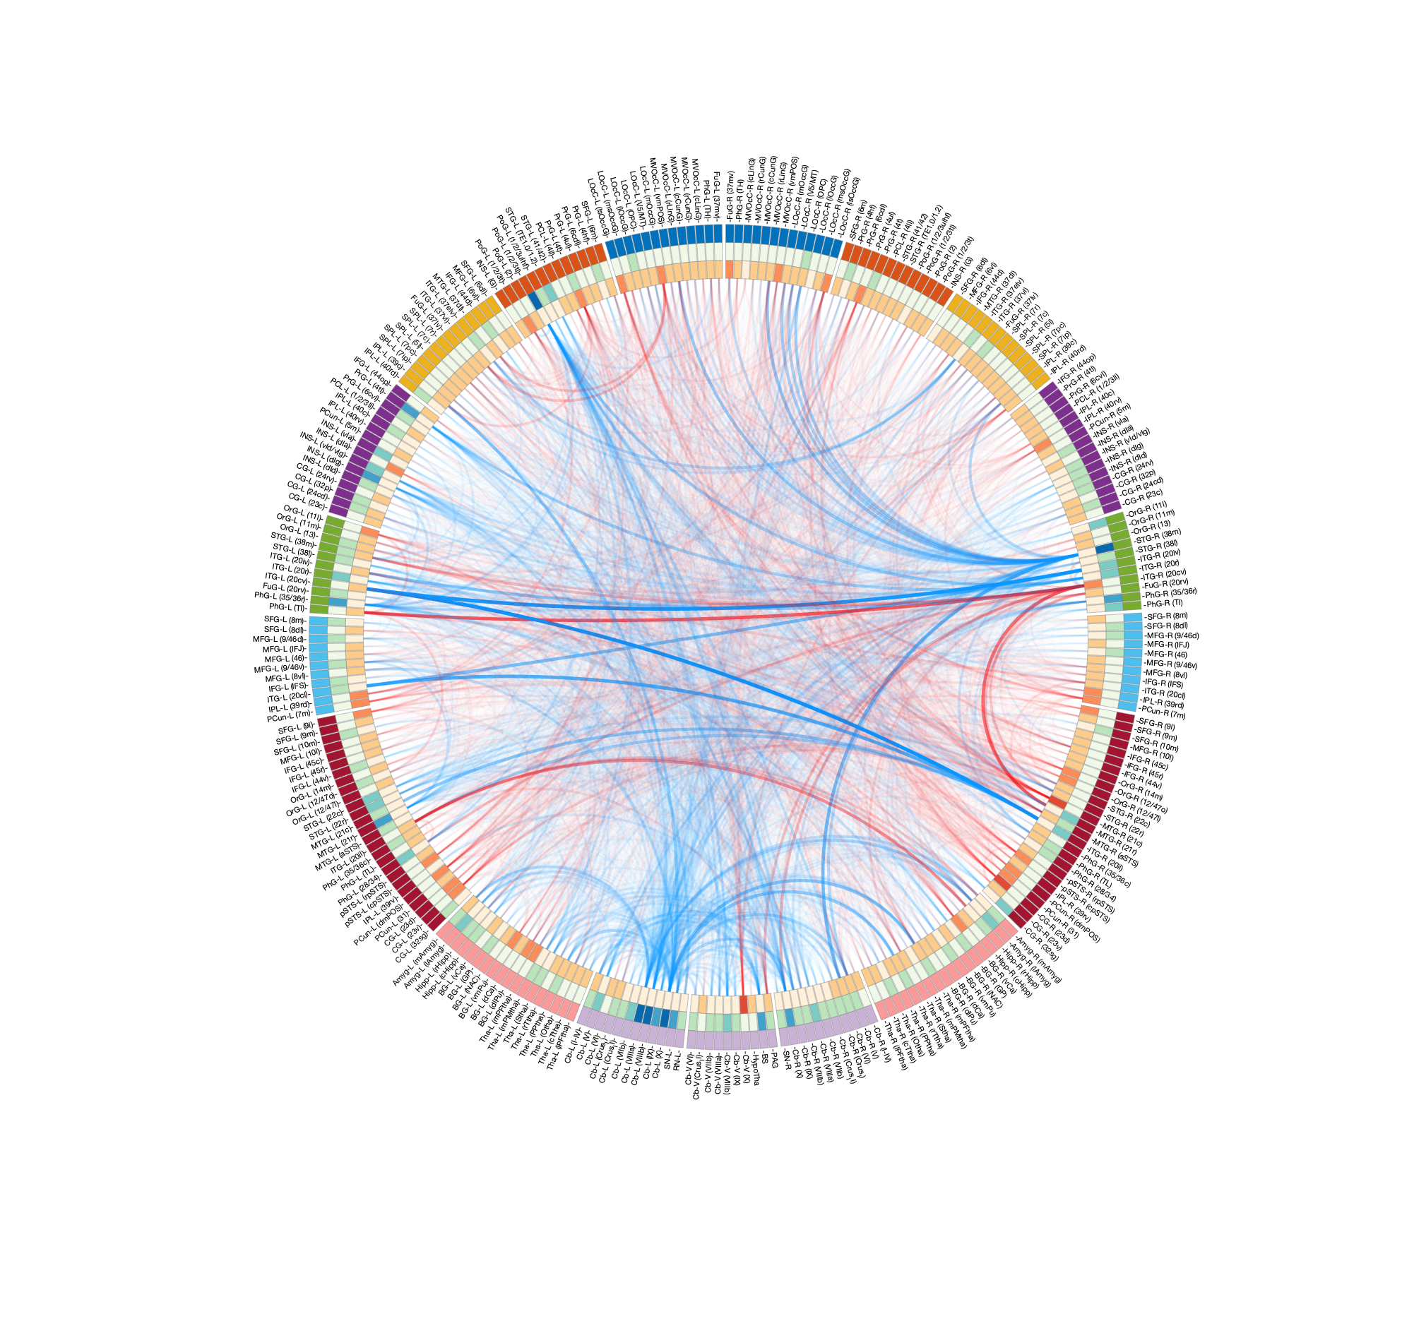
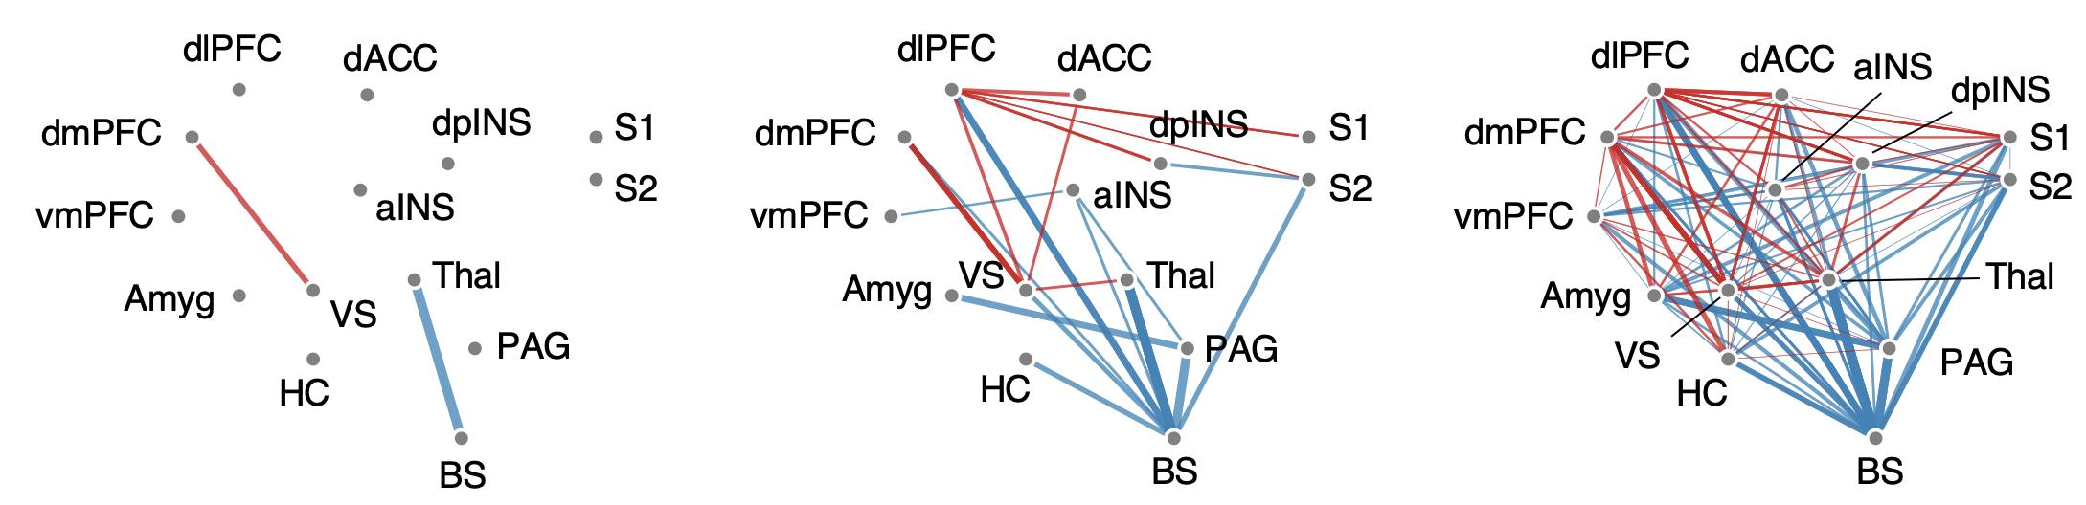


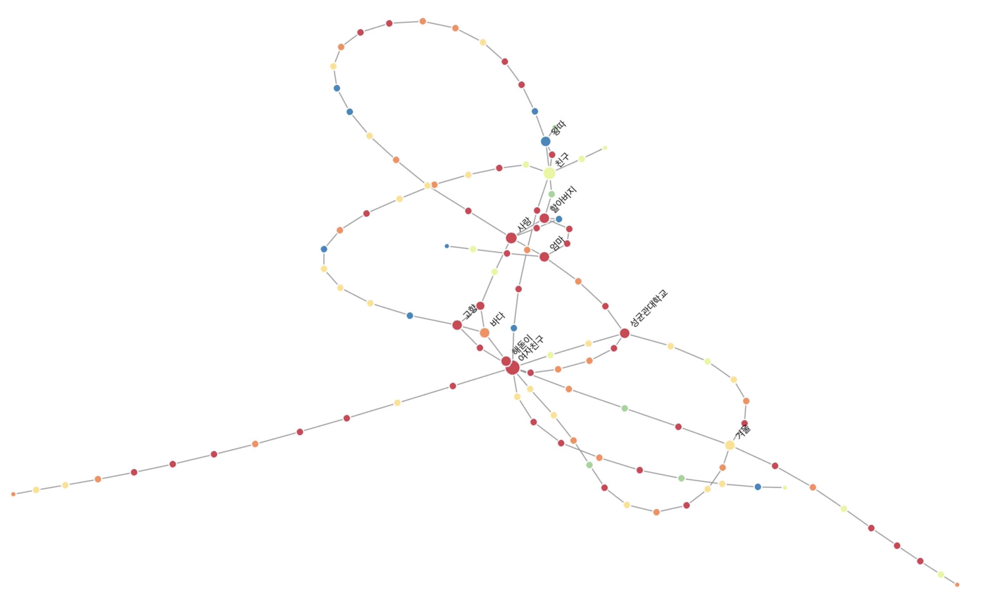
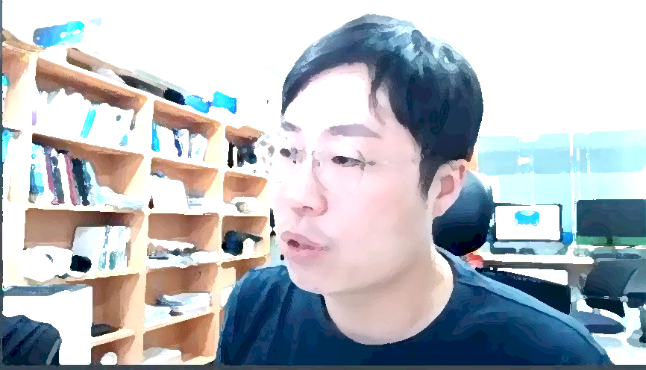
Affective Neuroscience in a digital age
Choong-Wan Woo
Computational Cognitive Affective Neuroscience Lab (Cocoan lab)
Center for Neuroscience Imaging Research, Institute for Basic Science
Department of Global Biomedical Engineering, Sungkyunkwan University
Web: http://cocoanlab.github.io
2020.05.20

Slide 2

Affective Neuroscience in a digital age
Choong-Wan Woo
Computational Cognitive Affective Neuroscience Lab (Cocoan lab)
Center for Neuroscience Imaging Research, Institute for Basic Science
Department of Global Biomedical Engineering, Sungkyunkwan University
Web: http://cocoanlab.github.io
2020.05.20

Slide 3

What is emotion?

Slide 4


What is emotion?
“It is widely agreed that emotion refers to a collection of psychological states that include subjective experience, expressive behavior (e.g., facial, bodily, verbal), and peripheral physiological responses (e.g., heart rate, respiration).”
“It is also widely agreed that emotions are a central feature in any psychological model of the human mind.”
“Beyond these two points of agreement, however, almost everything else seems to be subject to debate.”
감정이 무엇인지는 어떻게 감정이 만들어지는지에 대해 여러분이 어떤 이론을 가지고 있는지에 따라 달라집니다.
Barrett, 2017
http://cocoanlab.github.io

Slide 5
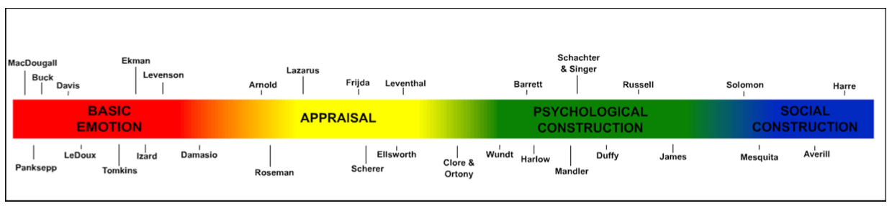
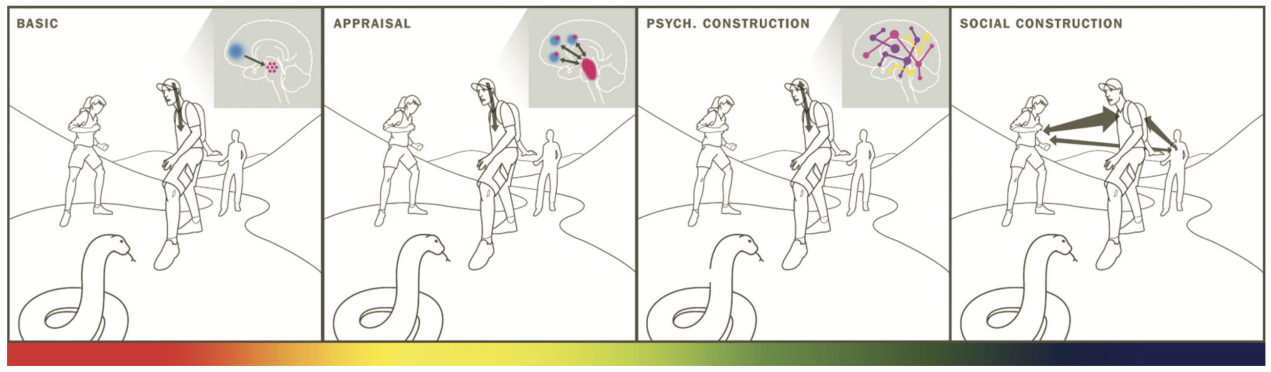
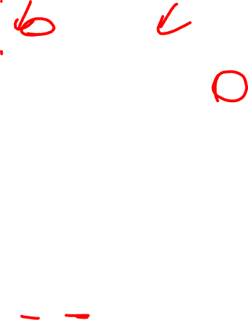
Theories of emotion
Gross and Barrett, 2011
http://cocoanlab.github.io

Slide 6

BASIC EMOTION
http://cocoanlab.github.io

Slide 7
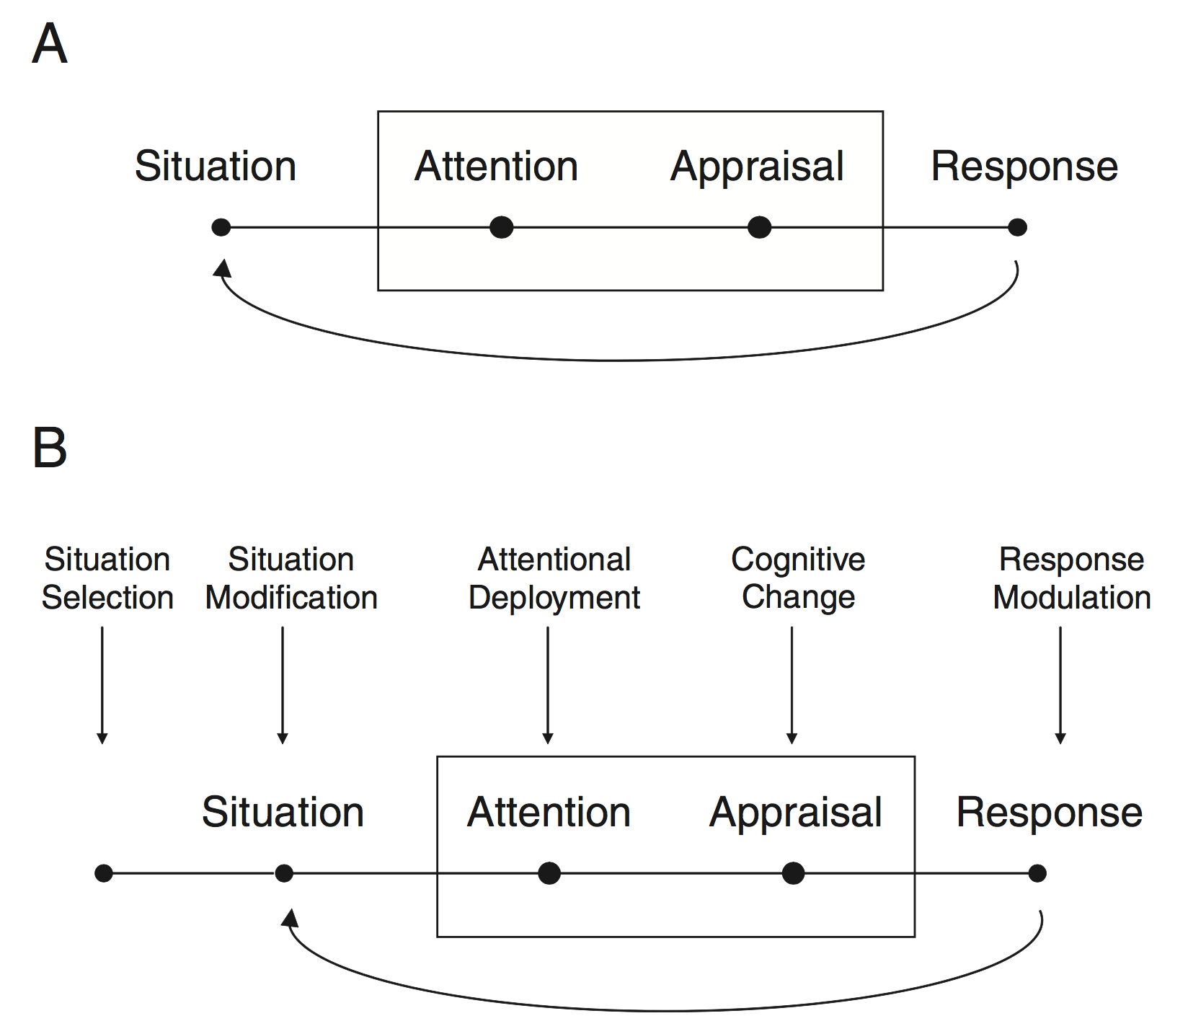
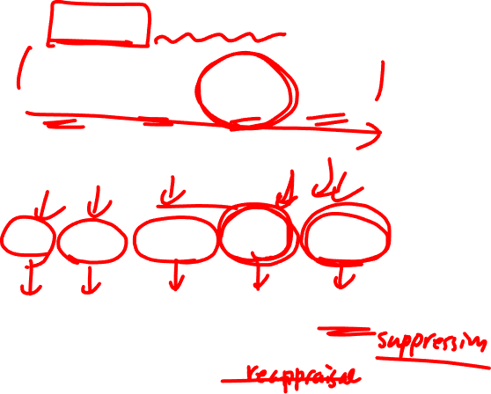
APPRAISAL
James Gross’s emotion generation model
Emotion regulation model
http://cocoanlab.github.io

Slide 8
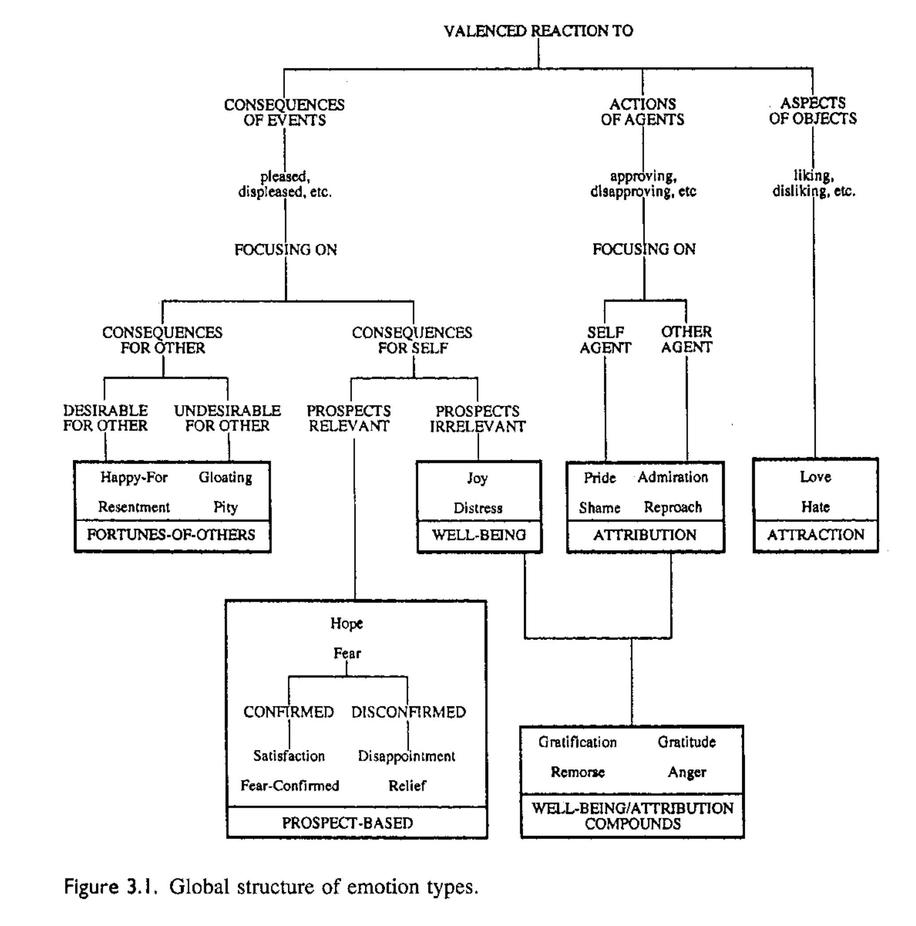
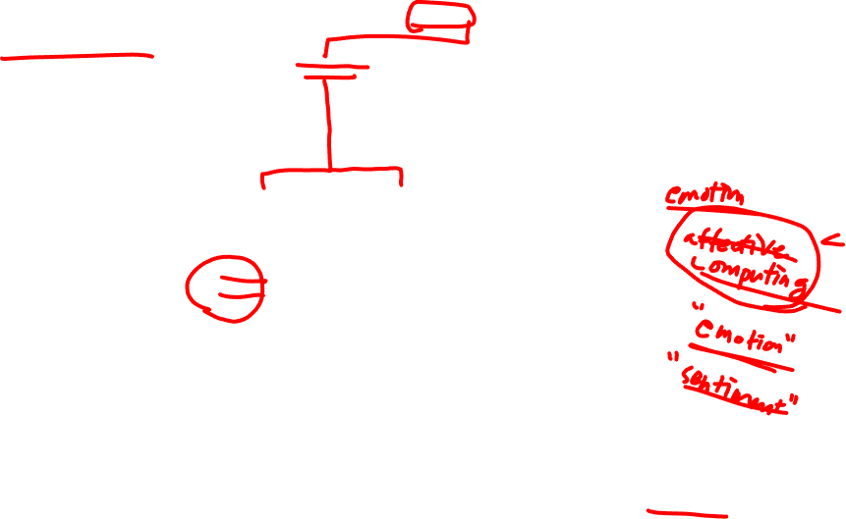
APPRAISAL
http://cocoanlab.github.io
Clore & Ortony, 2000

Slide 9
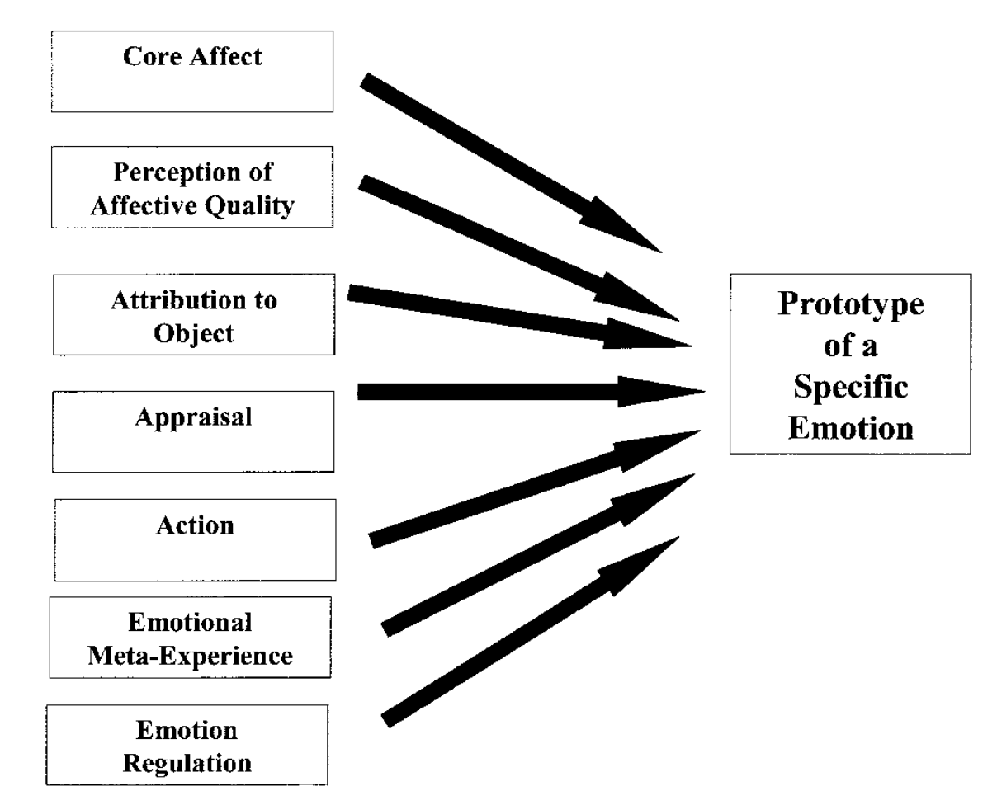
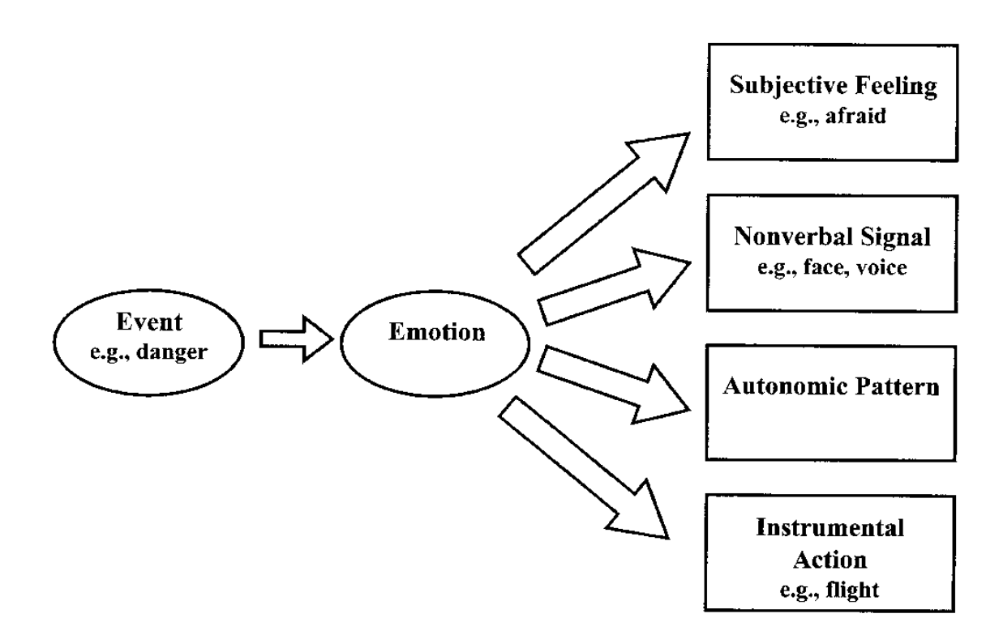
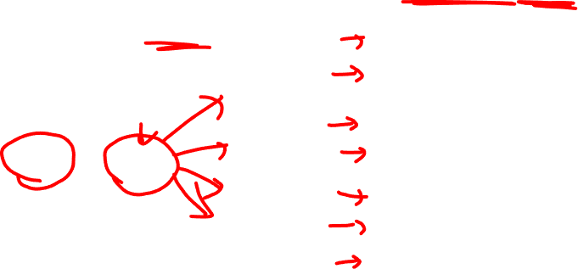
CONSTRUCTION
Alternative view: Emotion as a construct
Traditional view: Emotion as a mediator
Russell, 2003
http://cocoanlab.github.io

Slide 10
What is affect?
가치, 생존, 행복 등에 관련된 뇌/마음의 기초적인 프로세스
쾌와 불쾌 (valence), 각성과 안정 (arousal) 의 모든 정도를 포괄하는 느낌과 감각
의식의 중요한 한 특징
감정을 이루는 기본 구성요소
반드시 의식을 필요로 하진 않음
내수용성 감각 (interoception) 과 밀접하게 연관
Interoception: 몸 내부 상태에 대한 감각
http://cocoanlab.github.io

Slide 11
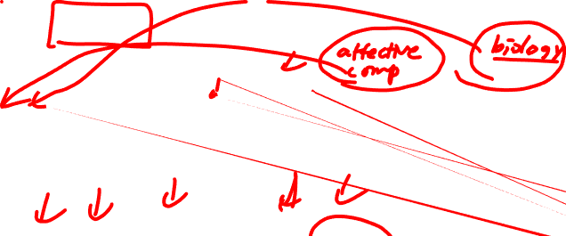
Where are you in this spectrum?
Gross and Barrett, 2011
http://cocoanlab.github.io

Slide 12
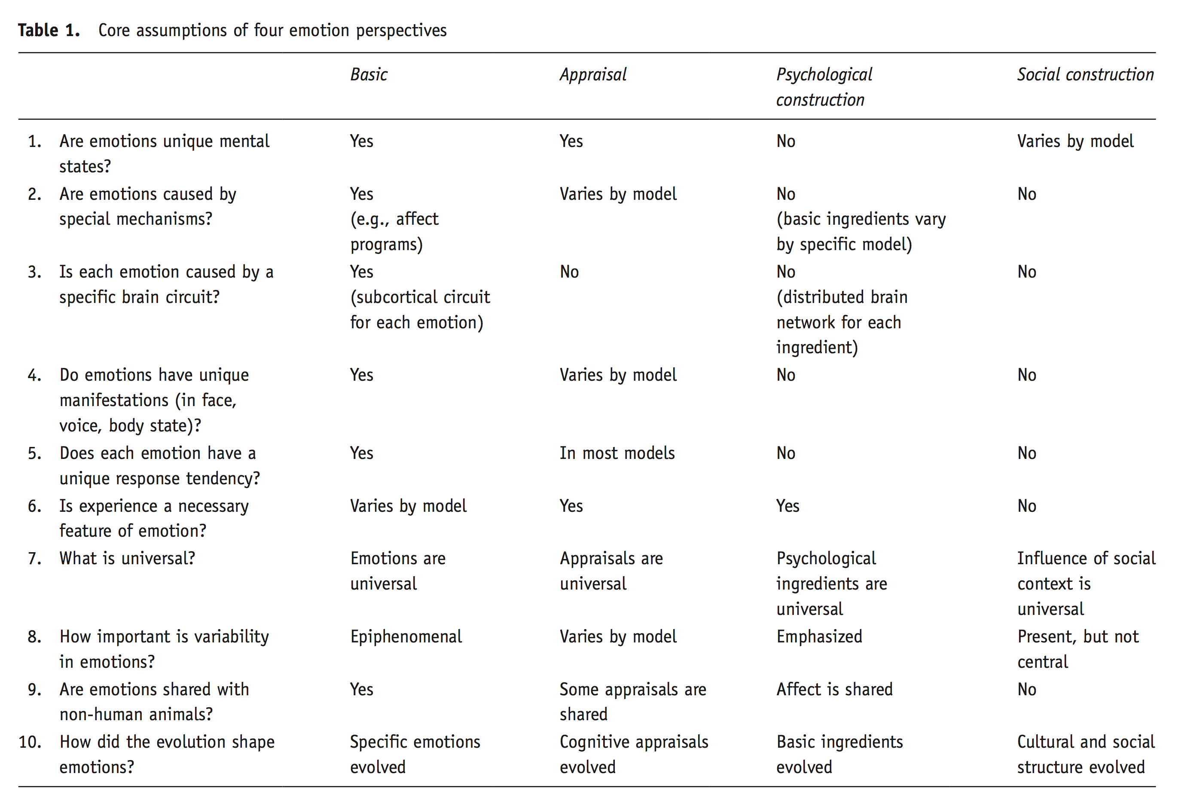

http://cocoanlab.github.io
Gross and Barrett, 2011

Slide 13
Where am I?
Choong-Wan Woo
Gross and Barrett, 2011
http://cocoanlab.github.io

Slide 14
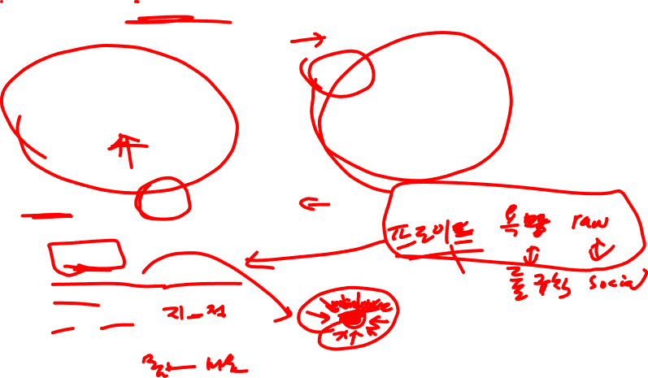
What is the common theme here?
Choong-Wan Woo
Emotions are more malleable than you think!
Even for pain!
Against Dualism:
Emotion generation vs. regulation?
Cognition vs. Emotion?
Body vs. mind?
http://cocoanlab.github.io

Slide 15
Emotions are more malleable than you think!
Against dualism (1): Emotion generation vs. regulation??
Against dualism (2): Cognition vs. Emotion?
Against dualism (3): Body vs. mind?

Slide 16
Emotions are more malleable than you think!
Against dualism (1): Emotion generation vs. regulation??
Against dualism (2): Cognition vs. Emotion?
Against dualism (3): Body vs. mind?
(The case of pain)

Slide 17
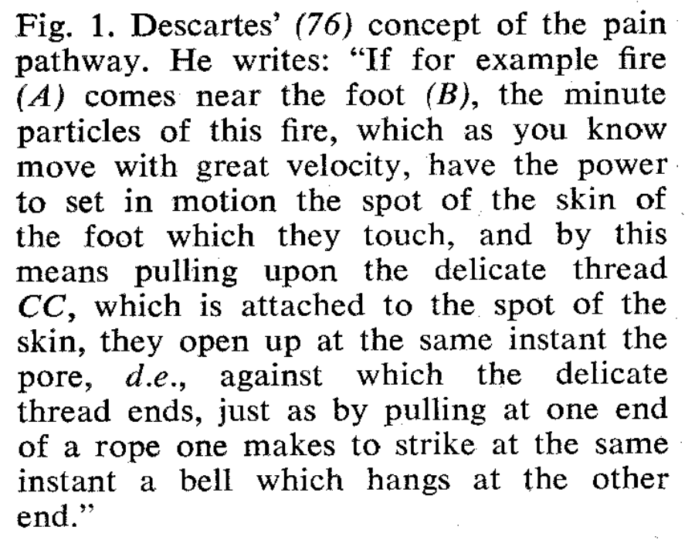
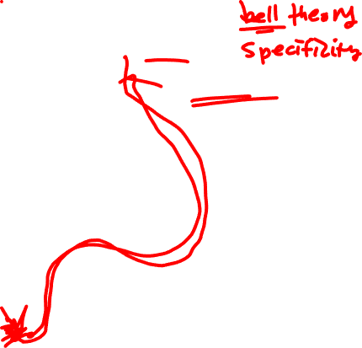
Pain pathway v1.0
띵똥
Descartes’ pain pathway
Melzack, 1965, Science
http://cocoanlab.github.io

Slide 18
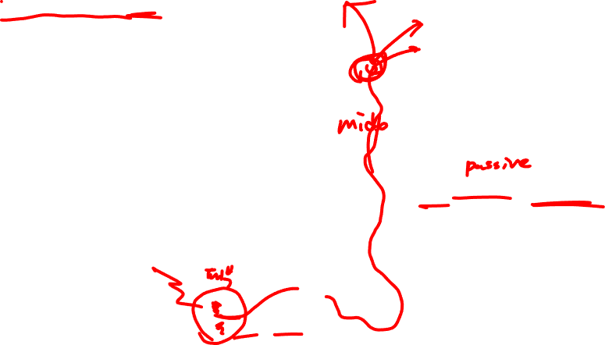
Pain pathway v1.0
Pain = response to noxious input
A-delta, C nerve fibers
Zhou & Verne, 2014, Nat Rev Gastro & Hepa
http://cocoanlab.github.io
Notes:
Pain is experienced when there is noxious input or peripheral injury. Nociceptive signal from periphery is transmitted through spinal cord and arrives at the brain. However, the brain is not a passive organ. The brain plays an active role in processing noxious input. It can filter, select, and modulate nociceptive signal. Importantly, to some degree, it happens automatically.

Slide 19
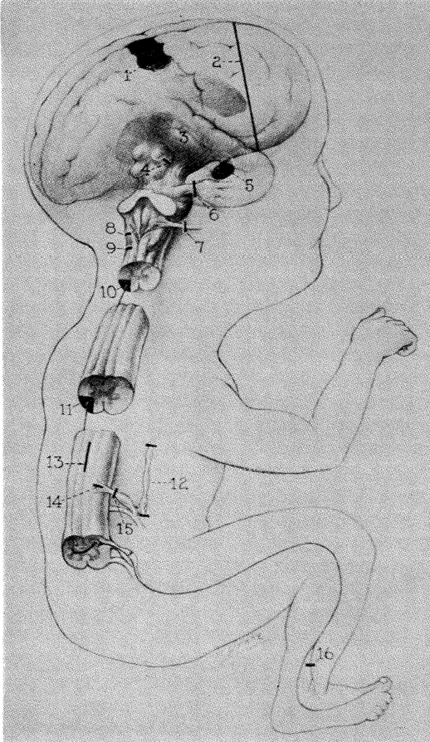
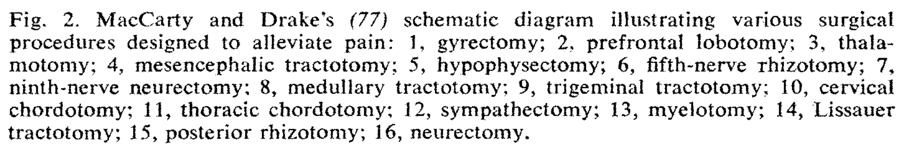
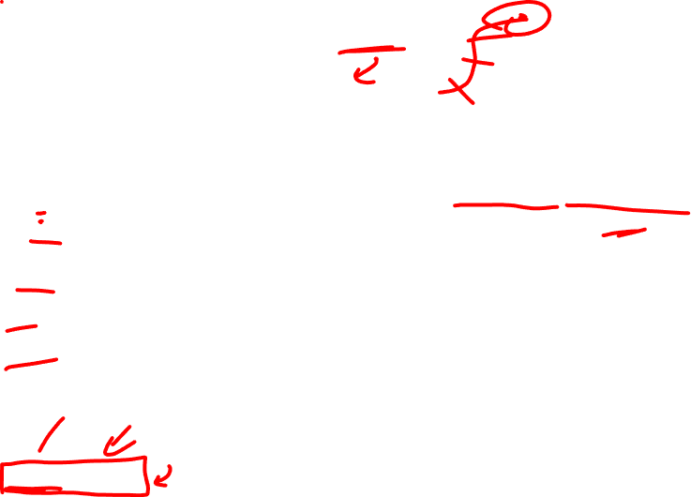
Treatment according to the pain pathway v1.0
Surgical interventions for pain: Cut the pathway
Selective benefits (they don’t always work!!)
Sometimes makes pain worse
Gyrectomy (cingulotomy)
Frontal lobotomy
Thalamotomy
Mesencephalic tractotomy
Hypophysectomy (pituitary)
C.N. V
C.N. IX
Medullary tract
Trigeminal tract
10, 11 Spinal cord
Sympathetic ganglia
Crossing STT fibers
Zone of Lissauer
15, 16 Peripheral nerves or roots
Melzack, 1965, Science
http://cocoanlab.github.io

Slide 20
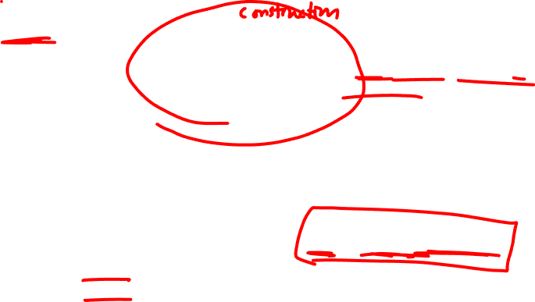
Pain pathway v2.0
S1
PFC
ACC
BG
Brain filters, selects, and modulates noxious inputs.
S2
Insula
AMY
>
Pain response to noxious input
Peripheral noxious input
Spinal cord
A-delta, C nerve fibers
http://cocoanlab.github.io
Notes:
Pain is experienced when there is noxious input or peripheral injury. Nociceptive signal from periphery is transmitted through spinal cord and arrives at the brain. However, the brain is not a passive organ. The brain plays an active role in processing noxious input. It can filter, select, and modulate nociceptive signal. Importantly, to some degree, it happens automatically.

Slide 21

Evidence 1: Endogenous fluctuations in pain experience
An example participant trial-by-trial pain ratings
48ºC
47ºC
44ºC
Pain ratings
42ºC
Trials
Woo et al., 2017, Nature Communications
http://cocoanlab.github.io
Notes:
Let me show you a very simple, but convincing example for that.
Even in a this simple illustration with a participant’s trial-by-trial pain rating data, we can see endogenous fluctuations in pain experience. That is

Slide 22
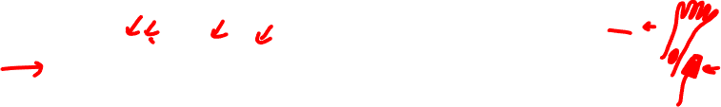
Evidence 1: Endogenous fluctuations in pain experience
An example participant trial-by-trial pain ratings
48ºC
47ºC
44ºC
Pain ratings
42ºC
Trials
Woo et al., 2017, Nature Communications
http://cocoanlab.github.io
Notes:
Let me show you a very simple, but convincing example for that.
Even in a this simple illustration with a participant’s trial-by-trial pain rating data, we can see endogenous fluctuations in pain experience. That is

Slide 23

Evidence 1: Endogenous fluctuations in pain experience
An example participant trial-by-trial pain ratings
48ºC
47ºC
44ºC
Pain ratings
42ºC
Trials
Even after removing stimulus intensity,
45-55% variance still remains to be explained.
Pain ratings
Woo et al., 2017, Nature Communications
Trials (sorted by temperature)
http://cocoanlab.github.io
Notes:
Let me show you a very simple, but convincing example for that.
Even in a this simple illustration with a participant’s trial-by-trial pain rating data, we can see endogenous fluctuations in pain experience. That is

Slide 24
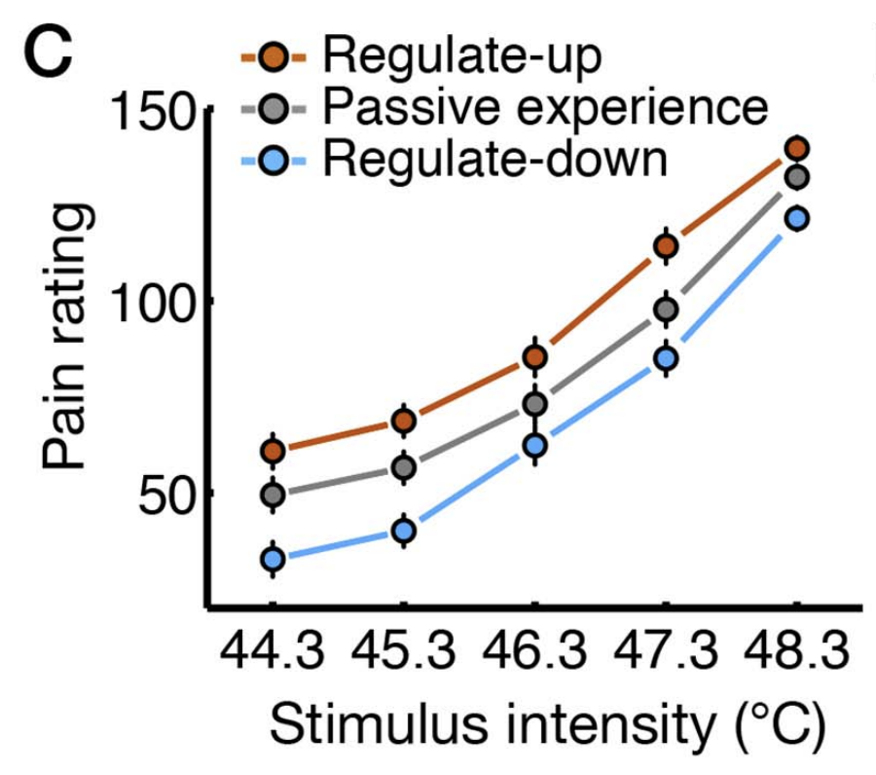
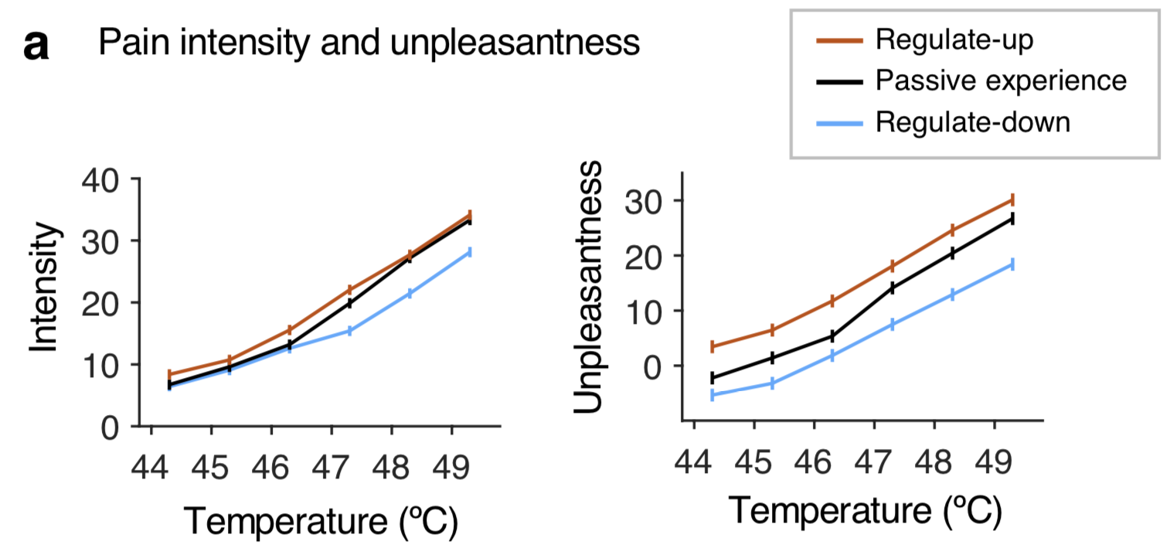
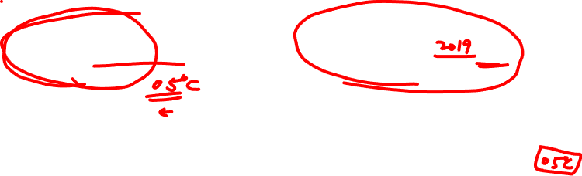
Evidence 2: Just rethinking (cognitive self-regulation) can change pain
Woo et al., 2015, PLoS Biology
(Replication) Matthewson, Woo et al., in press, PAIN
http://cocoanlab.github.io
Notes:
Let me show you a very simple, but convincing example for that.
Even in a this simple illustration with a participant’s trial-by-trial pain rating data, we can see endogenous fluctuations in pain experience. That is

Slide 25
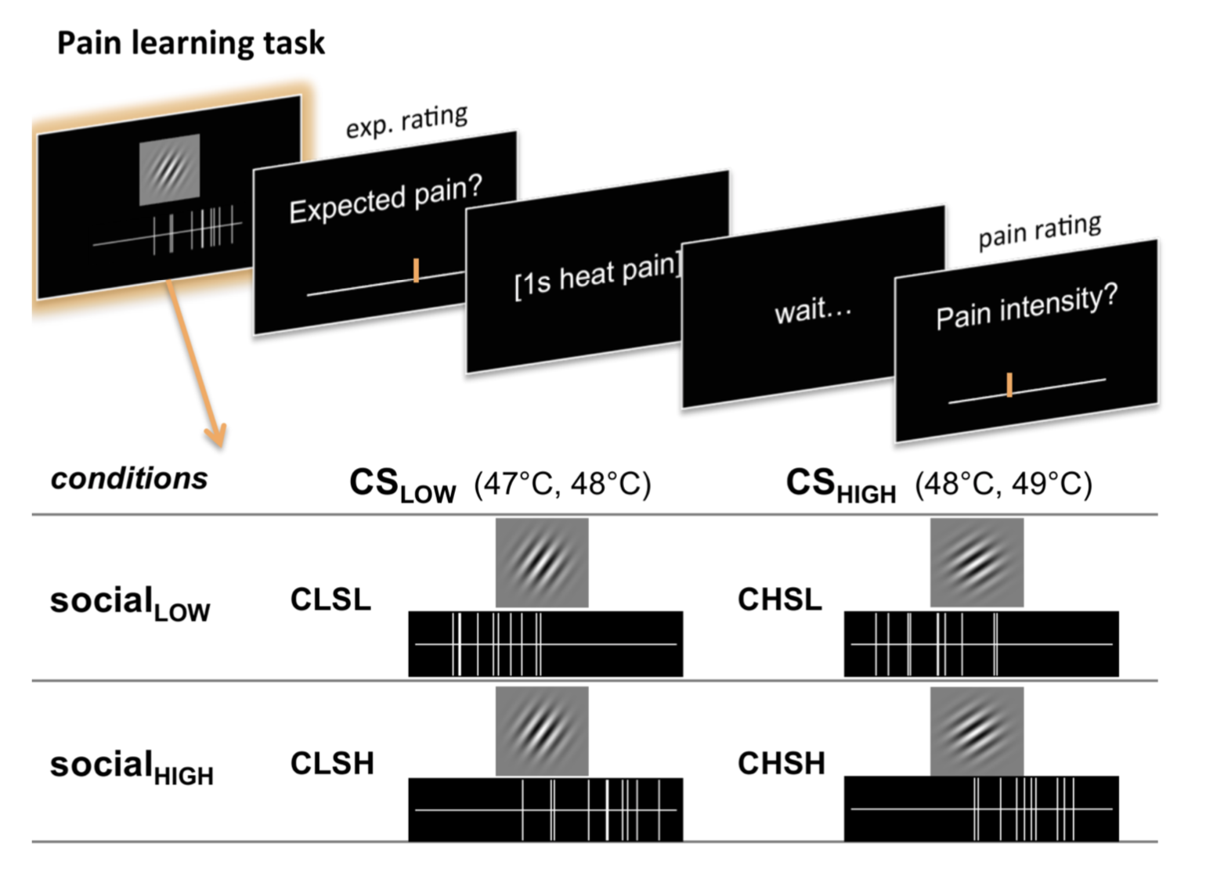
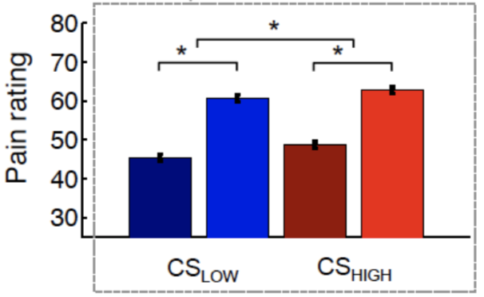
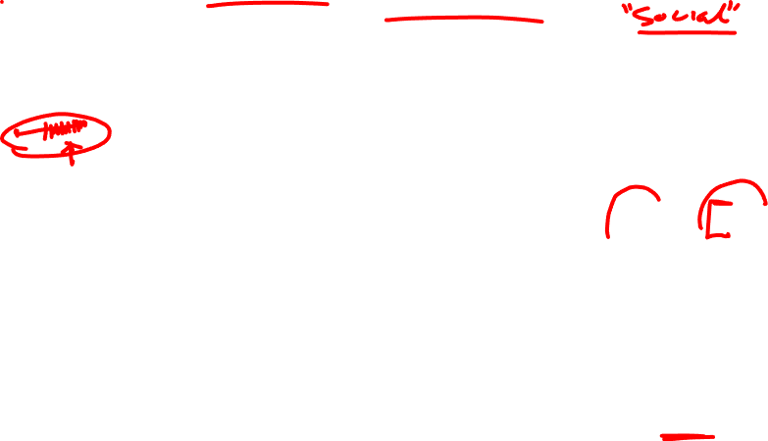
Evidence 3: how other people rated can change pain
Same temperature (48ºC)
Social cue
effects
Social cue
effects
Koban et al., 2016, Emotion
http://cocoanlab.github.io
Notes:
Let me show you a very simple, but convincing example for that.
Even in a this simple illustration with a participant’s trial-by-trial pain rating data, we can see endogenous fluctuations in pain experience. That is

Slide 26
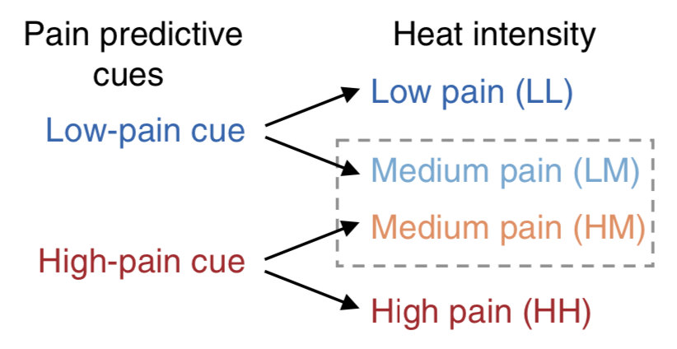
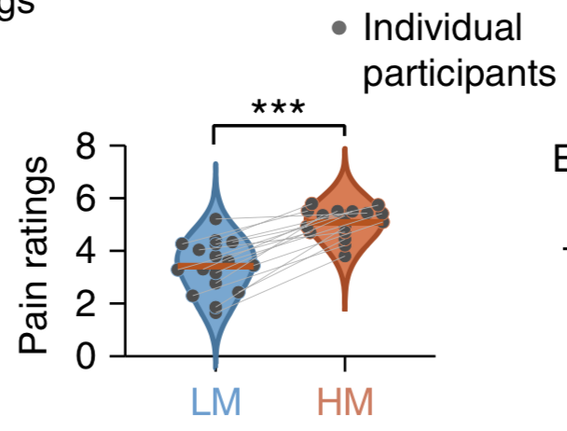
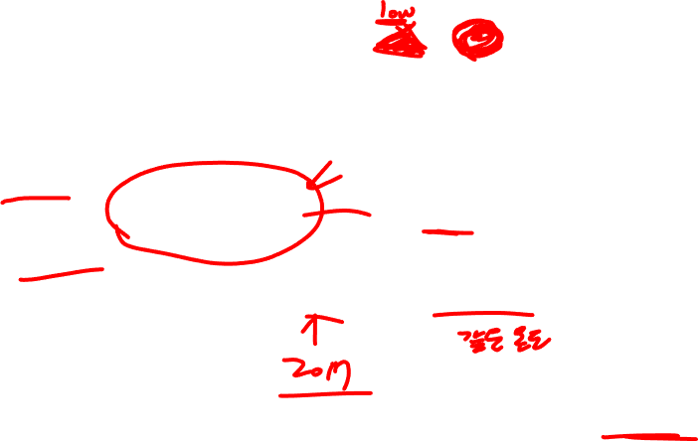
Evidence 4: Expectation (and placebo effects) can change pain
Atlas et al., 2010, J Neuro
http://cocoanlab.github.io
Notes:
Let me show you a very simple, but convincing example for that.
Even in a this simple illustration with a participant’s trial-by-trial pain rating data, we can see endogenous fluctuations in pain experience. That is

Slide 27
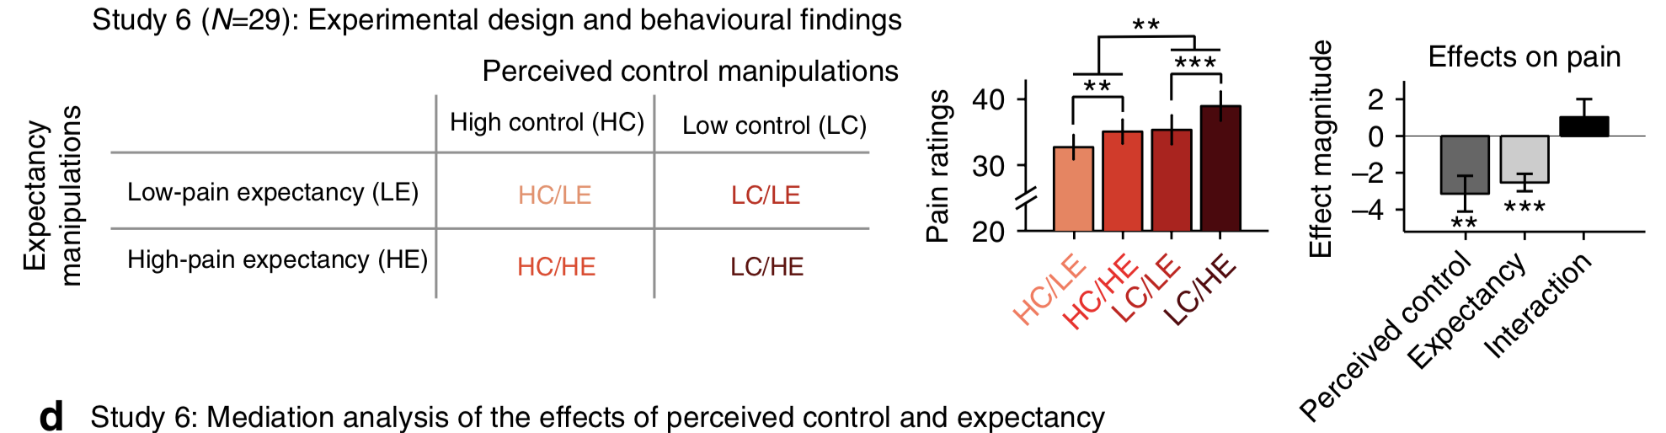
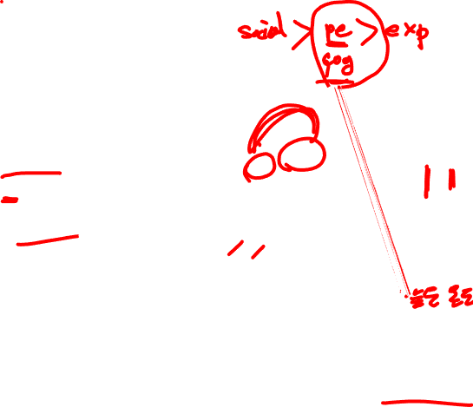
Evidence 5: Perceived control can change pain
Woo et al., 2017, Nat Comms
http://cocoanlab.github.io
Notes:
Let me show you a very simple, but convincing example for that.
Even in a this simple illustration with a participant’s trial-by-trial pain rating data, we can see endogenous fluctuations in pain experience. That is

Slide 28
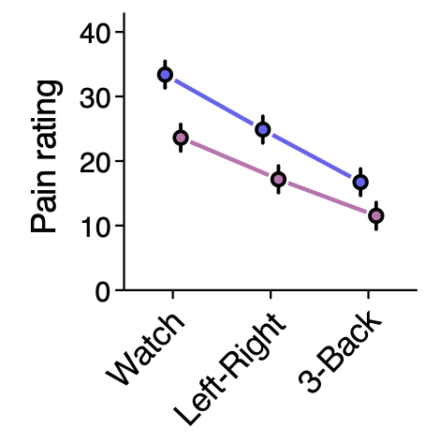
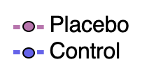

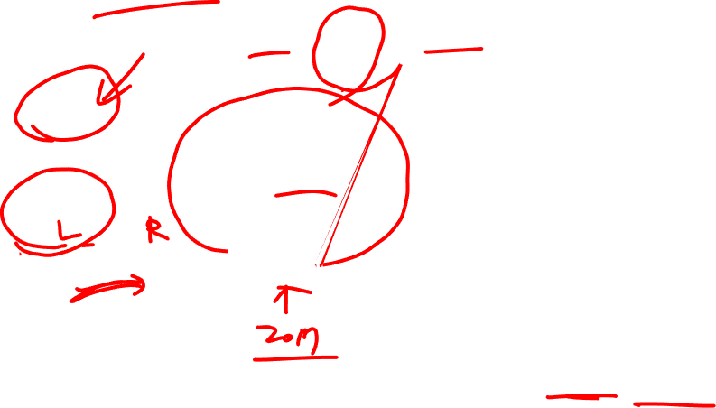
Evidence 6: Distraction can change pain
1) Watch:
3) 3-Back:
+
R
N
2) Left-Right:
S
R
L
R
T
Woo et al., in prep
http://cocoanlab.github.io
Notes:
Let me show you a very simple, but convincing example for that.
Even in a this simple illustration with a participant’s trial-by-trial pain rating data, we can see endogenous fluctuations in pain experience. That is

Slide 29
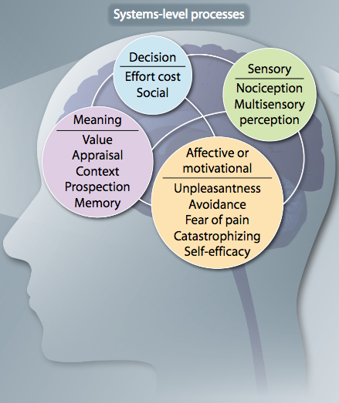
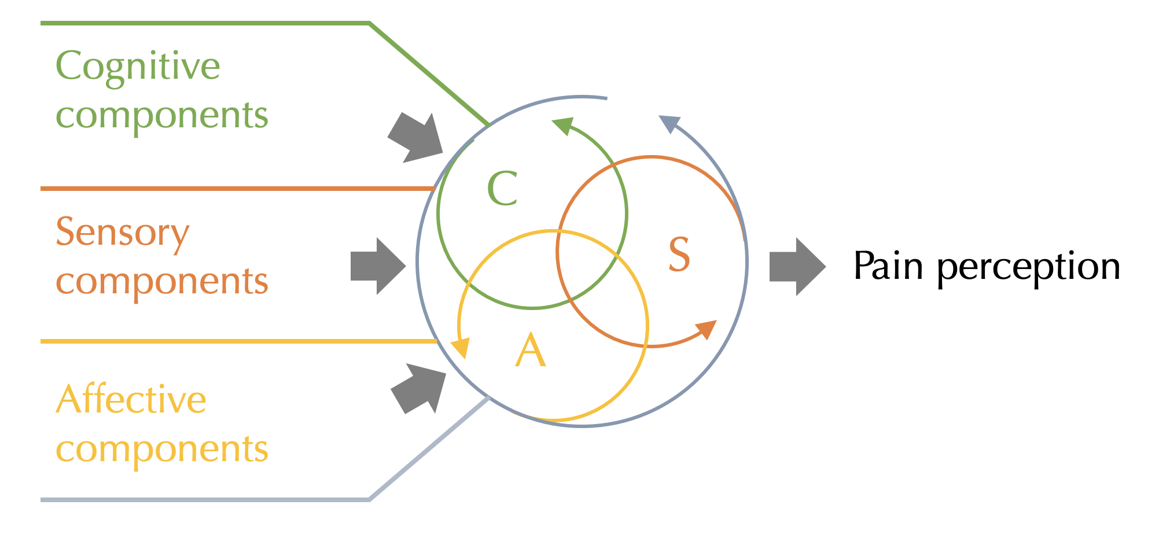
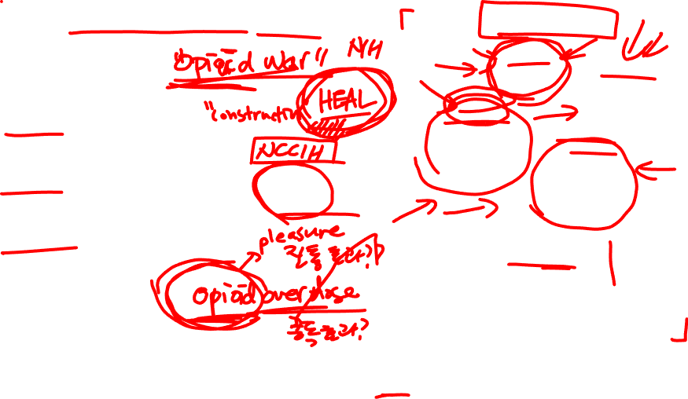
Pain as a multidimensional experience
Nociceptive input
Adapted from Melzack, 2005, Pain Practice
Wager & Woo, 2015, Science Translational Medicine
http://cocoanlab.github.io
Notes:
Let me show you a very simple, but convincing example for that.
Even in a this simple illustration with a participant’s trial-by-trial pain rating data, we can see endogenous fluctuations in pain experience. That is

Slide 30
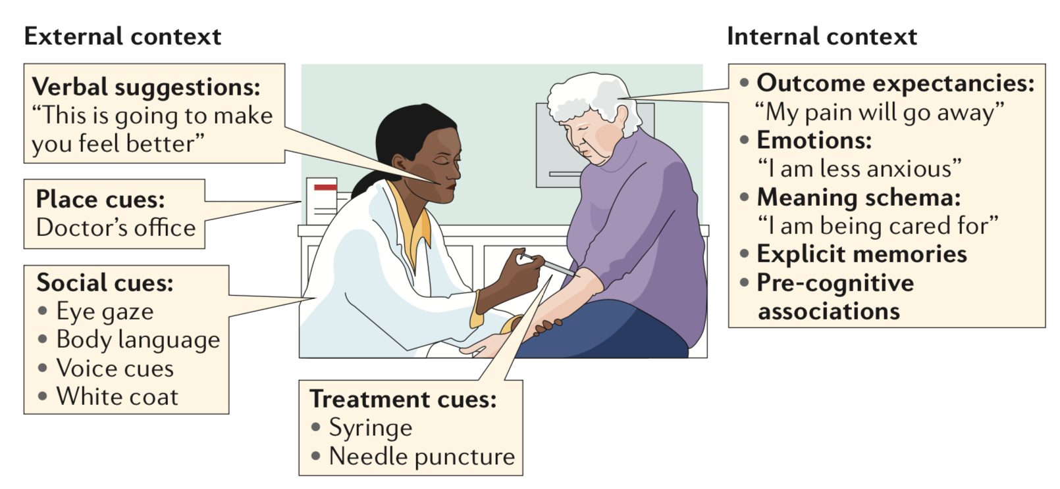
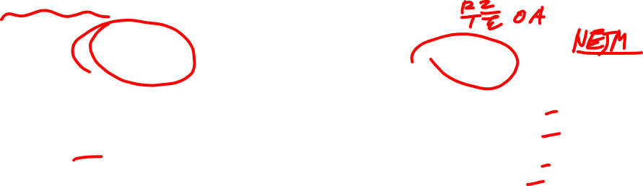
Treating pain by altering multidimensional contexts
Wager & Atlas, 2015, Nature Reviews Neuroscience
http://cocoanlab.github.io
Notes:
Let me show you a very simple, but convincing example for that.
Even in a this simple illustration with a participant’s trial-by-trial pain rating data, we can see endogenous fluctuations in pain experience. That is

Slide 31
Emotions are more malleable than you think!
Against dualism (1): Emotion generation vs. regulation??
Against dualism (2): Cognition vs. Emotion?
Against dualism (3): Body vs. mind?
(The case of pain)

Slide 32
Emotions are more malleable than you think!
Against dualism (1): Emotion generation vs. regulation??
Against dualism (2): Cognition vs. Emotion?
Against dualism (3): Body vs. mind?
(The case of pain)

Slide 33
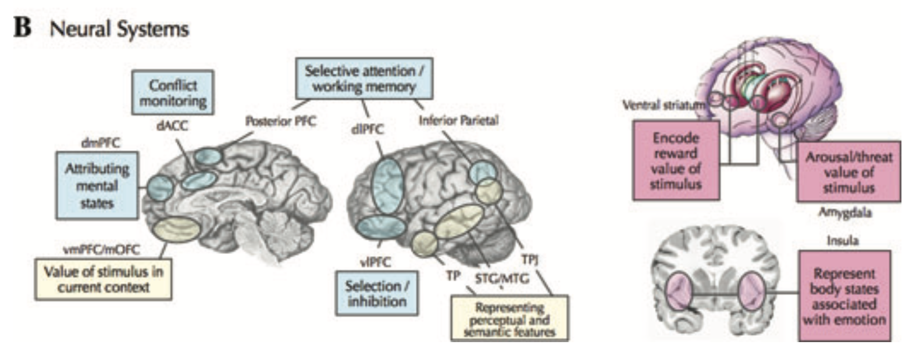
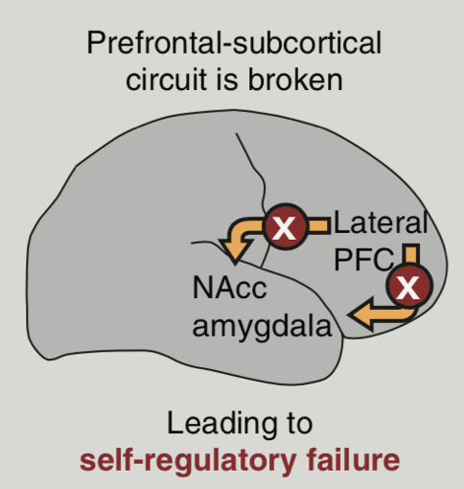
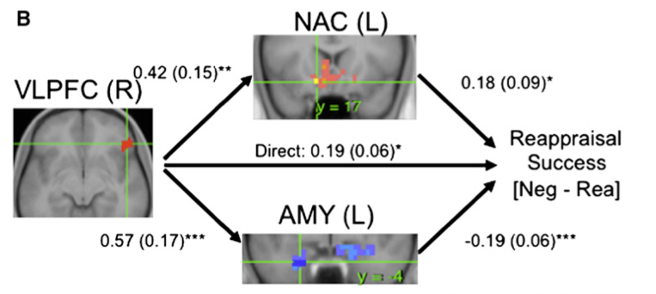
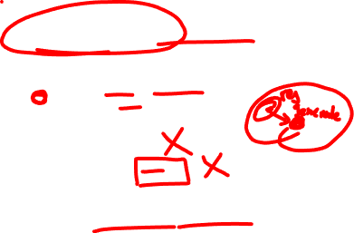
Emotion generation vs. regulation??
Dominant view: dual system: Cortical (regulation) vs. sub-cortical (perception)
Heatherton & Wagner, 2011, TICS; Ochsner et al., 2012; Wager et al., 2008
http://cocoanlab.github.io
Notes:
Let me show you a very simple, but convincing example for that.
Even in a this simple illustration with a participant’s trial-by-trial pain rating data, we can see endogenous fluctuations in pain experience. That is

Slide 34
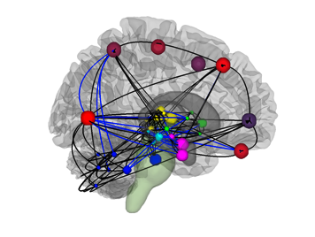
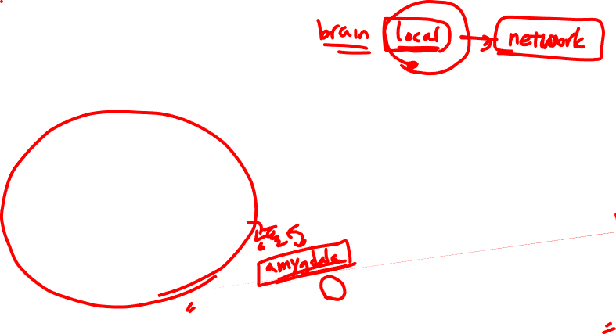
But what’s being regulated?
NAcc and amygdala:
Are these good markers for positive and negative emotions?
attention
action
prospection
perception
memory
metabolism
Emotion as coordinated brain responses across multiple-systems
Emotions are arbitrary “labels” for patterns of coordinated brain processes
Barrett, L.F. et al. 2006, 2009, 2013; Lindquist et al. 2011, 2012; J. Price, 1999; Bandler, 2000
http://cocoanlab.github.io

Slide 35




Our approach: Develop good markers first, then study the effects of regulation
Cognitive
self-regulation
x
Pain
There can be multiple independent neural pathways (ingredients) to construct pain and emotion experience (more constructionist view)
http://cocoanlab.github.io

Slide 36

Tonic pain marker: both sensation and coping
http://cocoanlab.github.io

Slide 37




Tonic pain marker: both sensation and coping
http://cocoanlab.github.io

Slide 38
Emotions are more malleable than you think!
Against dualism (1): Emotion generation vs. regulation??
Against dualism (2): Cognition vs. Emotion?
Against dualism (3): Body vs. mind?
(The case of pain)

Slide 39
Emotions are more malleable than you think!
Against dualism (1): Emotion generation vs. regulation??
Against dualism (2): Cognition vs. Emotion?
Against dualism (3): Body vs. mind?
(The case of pain)

Slide 40


How Emotions Are Made?
http://cocoanlab.github.io
Notes:
Let me show you a very simple, but convincing example for that.
Even in a this simple illustration with a participant’s trial-by-trial pain rating data, we can see endogenous fluctuations in pain experience. That is

Slide 41




Pain and pain regulation as predictive coding (Bayesian update)!
http://cocoanlab.github.io
Notes:
Pain is experienced when there is noxious input or peripheral injury. Nociceptive signal from periphery is transmitted through spinal cord and arrives at the brain. However, the brain is not a passive organ. The brain plays an active role in processing noxious input. It can filter, select, and modulate nociceptive signal. Importantly, to some degree, it happens automatically.

Slide 42




Treatment context as multidimensional priors
Geuter, Koban, & Wager, 2017, Annu. Rev. Neurosci.
http://cocoanlab.github.io
Notes:
Let me show you a very simple, but convincing example for that.
Even in a this simple illustration with a participant’s trial-by-trial pain rating data, we can see endogenous fluctuations in pain experience. That is

Slide 43



Emotion as a meaning construction
Expected sensory hedonic value
Social: “People like me eat healthy fruit, not candy bars.”
Cognitive: “This banana
contains healthy K+”
Interoception: “I’m hungry”
Drive, arousal: “Get the banana”
http://cocoanlab.github.io
Notes:
CCK:CHOLECYSTOKININ
PYY:PEPTIDE YY
PP: Pancreatic polypeptide

Slide 44











Emotion as visceral-affective-conceptual pattern generation process!
Conceptual pattern generators:
Situational schemas
Social context
DMPFC
Insula
Interoceptive
context
Memory, place context
vmPFC
Expected future events
Hipp
OFC
Affective pattern generators
Hy
Fight, escape, submit, pursue, recover, etc.
PAG
NAC
Amy
Visceral pattern generators
Thermoregulation, emesis, nociception, etc.
Wager & Atlas, 2015, Nature Reviews Neuroscience
http://cocoanlab.github.io

Slide 45
Emotions are more malleable than you think!
Against dualism (1): Emotion generation vs. regulation??
Against dualism (2): Cognition vs. Emotion?
Against dualism (3): Body vs. mind?
(The case of pain)

Slide 46
Emotions are more malleable than you think!
Against dualism (1): Emotion generation vs. regulation??
Against dualism (2): Cognition vs. Emotion?
Against dualism (3): Body vs. mind?
(The case of pain)

Slide 47
Emotion as visceral-affective-conceptual pattern generation process!
Conceptual pattern generators:
Situational schemas
Social context
DMPFC
Insula
Interoceptive
context
Memory, place context
vmPFC
Expected future events
Hipp
OFC
Affective pattern generators
Hy
Fight, escape, submit, pursue, recover, etc.
PAG
NAC
Amy
Visceral pattern generators
Thermoregulation, emesis, nociception, etc.
Wager & Atlas, 2015, Nature Reviews Neuroscience
http://cocoanlab.github.io

Slide 48



Chronic pain? Issues in internal contexts!
http://cocoanlab.github.io

Slide 49

The effects of concepts on bodily responses
We developed a novel task: Free-Association Semantic task
폐인
희망
롤
안해
다시는
슬픔
사람들
사랑
여자친구
곱창
눈물
공연
질투
피아노
음대
http://cocoanlab.github.io

Slide 50



The effects of concepts on bodily responses
Heart beat
http://cocoanlab.github.io

Slide 51




CNS control of ANS: Visceromotor network
Descending projections from multiple systems
Critical areas: Hypothalamus, PAG, amygdala, and medial prefrontal cortex, etc.
Called the “visceromotor” network or “central autonomic network”
http://cocoanlab.github.io

Slide 52


CNS control of ANS: Visceromotor network
http://cocoanlab.github.io

Slide 53

CNS control of ANS: Visceromotor network
Medical cortical
visceromotor
system
Central opioid and 5HT system
Central NE system
Cranial nerve nuclei and others
Sympathetic output
Parasympathetic output
Wager (2015), Benarroch (1993)
http://cocoanlab.github.io

Slide 54


What we are currently doing in the lab:
http://cocoanlab.github.io

Slide 55

What we are currently doing in the lab:
Neural basis of pain and emotion
regulation
Decoding internal thoughts and emotions
Translational
neuroimaging
Neuroimaging-based pain decoding
http://cocoanlab.github.io

Slide 56
Our lab’s research direction
Emotions are more malleable than you think!
Against dualism (1): Emotion generation vs. regulation??
Against dualism (2): Cognition vs. Emotion?
Against dualism (3): Body vs. mind?
(The case of pain)

Slide 57

Our lab’s research direction
Effective self-regulation (science of behavioral changes)
Against dualism (1): Emotion generation vs. regulation??
Against dualism (2): Cognition vs. Emotion?
Against dualism (3): Body vs. mind?

Slide 58
Our lab’s research direction
Effective self-regulation (science of behavioral changes)
Developing neuroimaging-based markers for pain and emotions
Against dualism (2): Cognition vs. Emotion?
Against dualism (3): Body vs. mind?

Slide 59
Our lab’s research direction
Effective self-regulation (science of behavioral changes)
Developing neuroimaging-based markers for pain and emotions
Modeling dynamic interactions between cognition and emotion, esp. predictive coding and internal thoughts
Against dualism (3): Body vs. mind?

Slide 60

Our lab’s research direction
Effective self-regulation (science of behavioral changes)
Developing neuroimaging-based markers for pain and emotions
Modeling dynamic interactions between cognition and emotion, esp. predictive coding and internal thoughts
Understanding how the mind influences the body (mind-body interaction)

Slide 61




Acknowledgement

